Slide 1

Team Members
1. Sri Harsha Linga
2. Mohan Reddy Kaja

Slide 2
Project Topic
Enhancing Customer Product Review Sentiment Analysis through Deep Learning Models Incorporating Acoustic and Textual Features

Slide 3
Objectives
Develop a hybrid sentiment analysis system that combines textual and acoustic features to provide a more nuanced understanding of customer sentiments in product reviews.
Evaluate the system's performance on diverse product categories and languages.
Investigate how the inclusion of acoustic features enhances sentiment analysis accuracy and overall understanding of customer feedback.
.

Slide 4
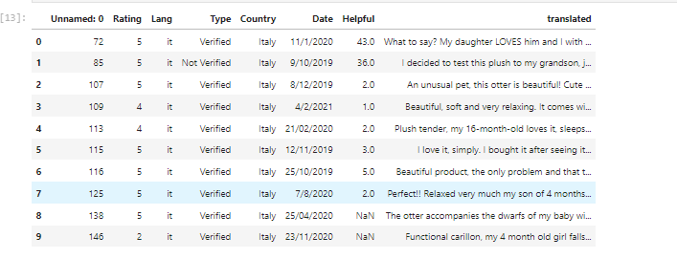
Data Collection
Collecting data from various sources, including both textual and acoustic data. The main dataset used in the development of this system was from Amazon customer reviews and ratings ("Reviews And Ratings.csv”) from Kaggle. Preprocessing steps were undertaken to ensure data quality and consistency.

Slide 5
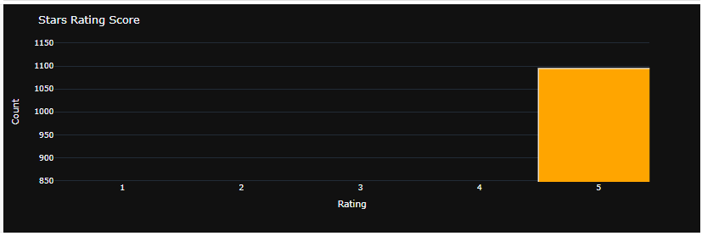
Exploratory Data Analysis (EDA)
Visualizations, such as histograms which showed that most of the customers rated the products at 5.

Slide 6
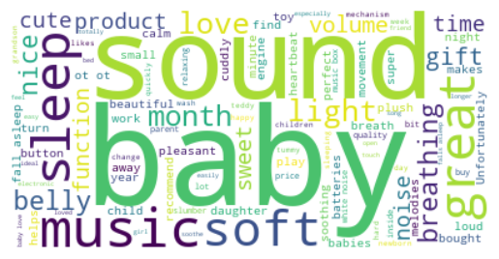
WordClouds-Positive
WordClouds visually depict the most prominent words in our reviews. These images give us an immediate sense of the language used in positive and negative sentiments.
The image depicts a word cloud with the words "sound baby" and "soft music" prominently used.

Slide 7
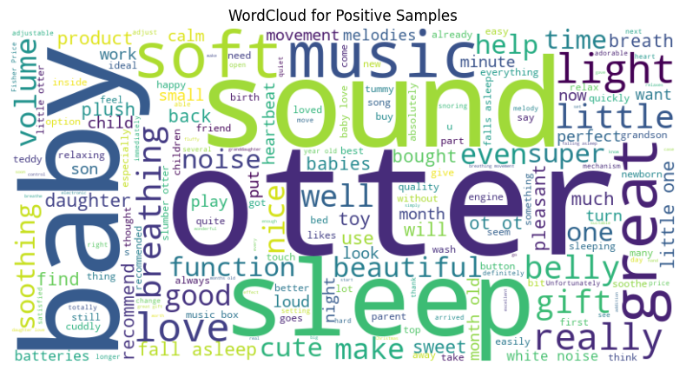
WordClouds -Positive
The showcases positive reviews of a product called "Fisher-Price Slumber Otter." The word cloud is dominated by phrases like "calm," "help," "works," "adjustable," "light," "sound," "melodies," "movement," and “ belly"
These words convey a sense of peace, comfort, and effectiveness, implying that the Slumber Otter is a valuable tool for soothing babies and promoting sleep

Slide 8
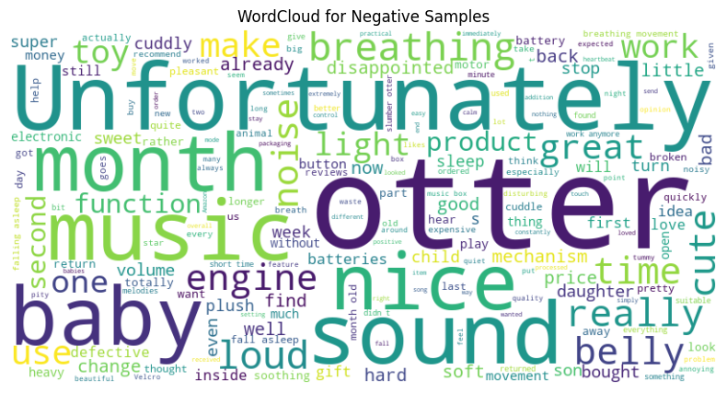
WordClouds -Positive
he word cloud highlights words like "money," "give," "broken," "expensive," "defective," "loud," "heavy," "expensive," "short," "totally," "annoying," "child," "batteries," "soft," "music," "quality," "ice," "mechanism," "price," "tone," "change," "movement," "well," "asleep," "looking for," "gift," and "hard."
These words collectively paint a picture of a product that has been met with dissatisfaction and negative experiences among users.

Slide 9
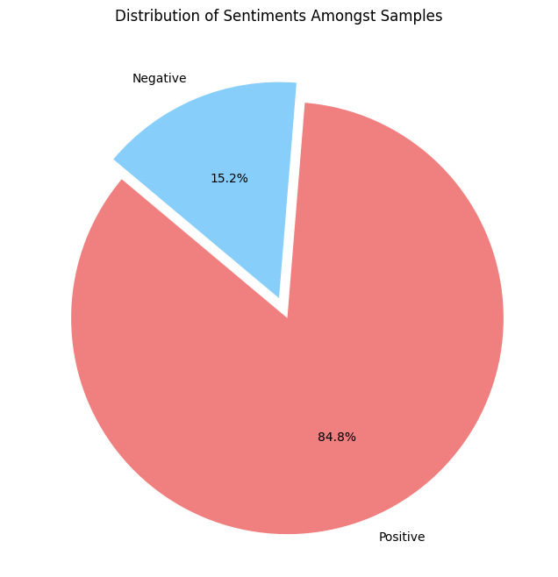
Sentiment Labeling
The pie chart shows that 84.8% of the samples are positive, while 15.2% are negative. This indicates that the overall sentiment for the topic or subject being analyzed is strongly positive.

Slide 10
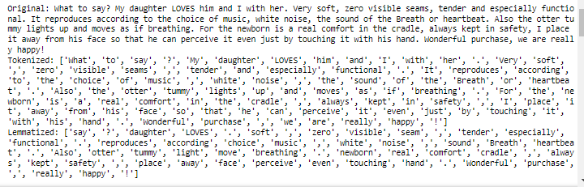
Tokenization and Lemmatization
Tokenization is the process of breaking down a text into individual words or tokens.
Lemmatization is the process of reducing words to their base or root form

Slide 11
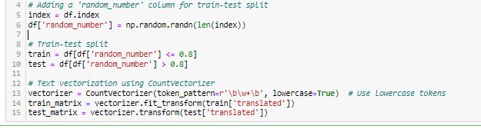
Methodology
We trained our models using a combination of textual and acoustic data, selected for their suitability in handling complex patterns across diverse product categories and languages.

Slide 12
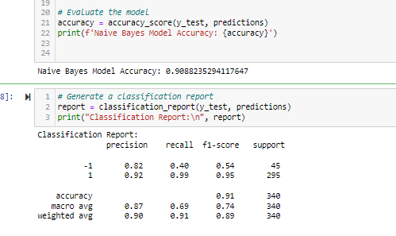
Methodology
Our Hybrid sentiment analysis system utilizes deep learning models, including LSTM, Naive Bayes, and Random Forest, to effectively combine both acoustic and textual features. Example of Naive Bayes Model Accuracy;

Slide 13
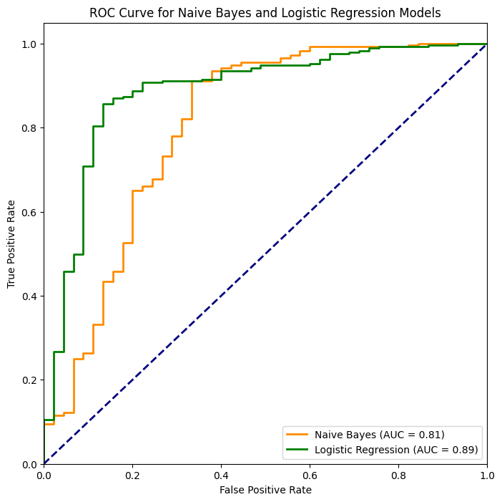
ROC Curve
The AUC for the Naive Bayes model is 0.81, while the AUC for the Logistic Regression model is 0.89. This means that the Logistic Regression model performs better than the Naive Bayes model, as it is able to correctly classify more positive samples (true positives) and fewer negative samples (false positives)

Slide 14
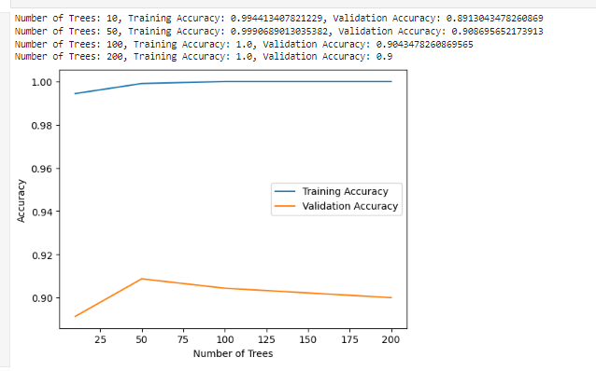
Model Accuracy
The graph shows that as the number of trees increases, the training accuracy also increases. The model is able to achieve high training accuracy, but it also shows signs of overfitting as the number of trees increases. The optimal number of trees for this model is around 50-100, which strikes a balance between accuracy and generalization.

Slide 15
THANK YOU
.

